Slide 1
Server-side scripting

Slide 2
Introduction
Web servers are used to execute server-side scripting.
They are basically used to create dynamic pages.
It can also access the file system residing at the webserver.
Scripts can be written in any of a number of server-side scripting languages available.
It is used to retrieve and generate content for dynamic pages.
When you need to store and retrieve information a database will be used to contain data. It can use huge resources of the server.
It reduces client-side computation overhead.
The server sends pages to the request of the user/client.

Slide 3
Server-side Programming
It is the program that runs on server dealing with the generation of content of web page. 1) Querying the database 2) Operations over databases 3) Access/Write a file on server. 4) Interact with other servers. 5) Structure web applications. 6) Process user input.

Slide 4
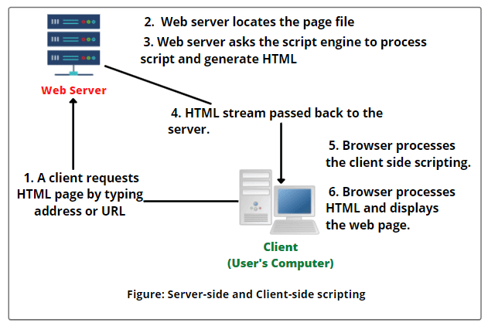
Client and server side scripting

Slide 5
PHP: Hypertext Preprocessor
HyperText means text containing all sorts of web markups, and PreProcessor means all of the HyperText is processed first.
Then, the result is sent as pure HTML to the web browser. A client cannot see the PHP source code because it is preprocessed and interpreted.
PHP (Hypertext Preprocessor) is an open-source HTML-embedded server-side scripting language used to develop dynamic and interactive web applications and as a general-purpose programming language.

Slide 6
PHP: Hypertext Preprocessor
PHP has many syntaxes similar to C, Java, and Perl and has many unique features and specific functions.
PHP page is a file with a .php extension can contain a combination of HTML Tags and PHP scripts.
PHP is Server-side scripting language: Server-side scripting means that the PHP code is processed on the web server rather than the client machine.
PHP supports many databases.

Slide 7
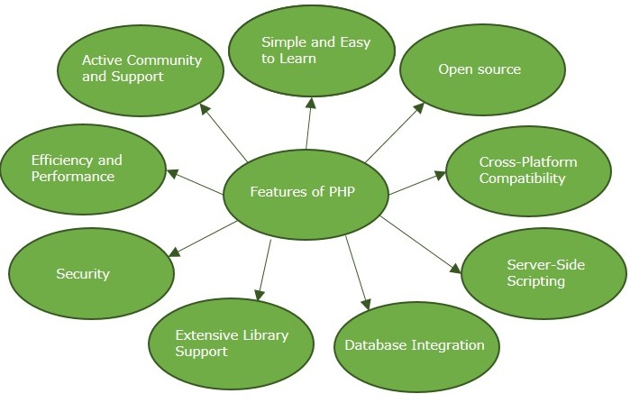
Features of PHP

Slide 8
Features of PHP
PHP performs system functions. It can create, open, read, write, and close the files.
PHP can handle forms. It can gather data from files, save data to a file, through email you can send data, return data to the user.
You add, delete, modify elements within your database through PHP.
Access cookies variables and set cookies.
Using PHP, you can restrict users to access some pages of your website.
It can encrypt data.

Slide 9
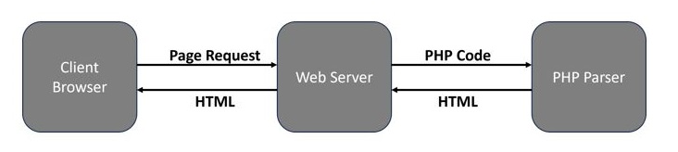
PHP - Syntax
A ".php" file may contain HTML, CSS and JavaScript code blocks along with the PHP code. Hence, the PHP parser must differentiate between the PHP code from the other elements.

Slide 10
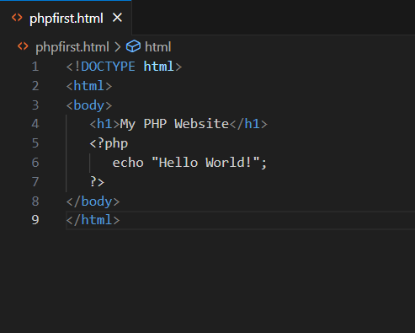
Example Code

Slide 11
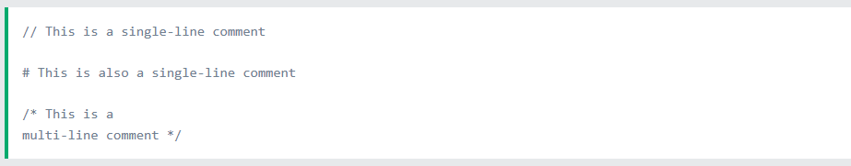
Syntax for comments in PHP code:

Slide 12
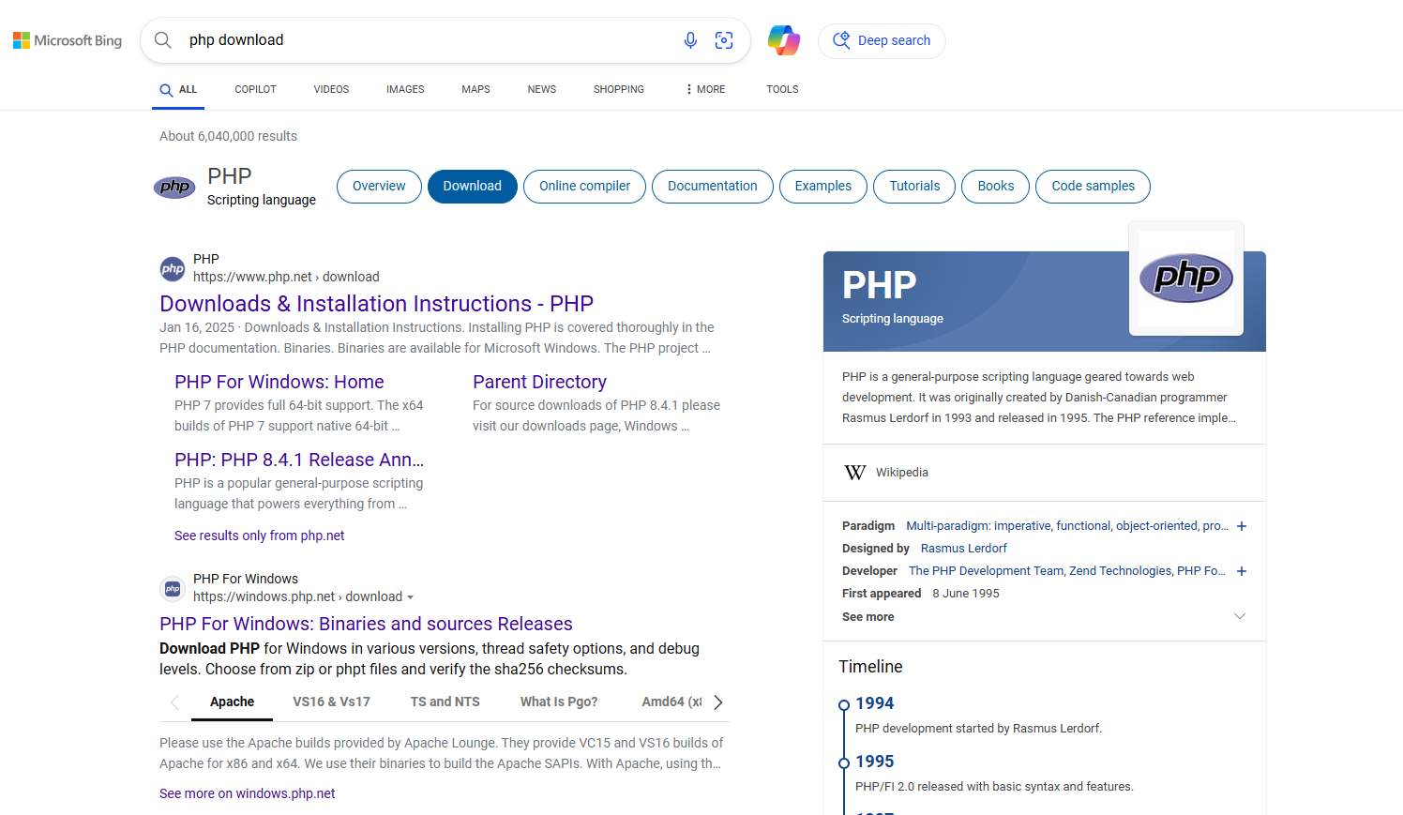
Search on browser for php download

Slide 13
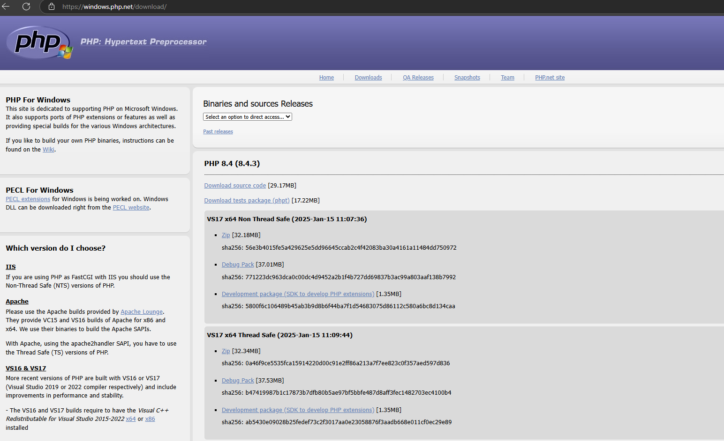
Select the link

Slide 14
Select VS17 x64 Thread Safe option to download
Select Zip file according to version you want to download.
Extract the file and rename it with short name.
Cut and Paste the extracted file to your defined location

Slide 15
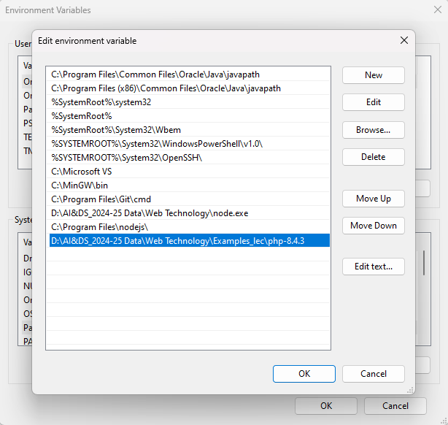
Set environment variable

Slide 16
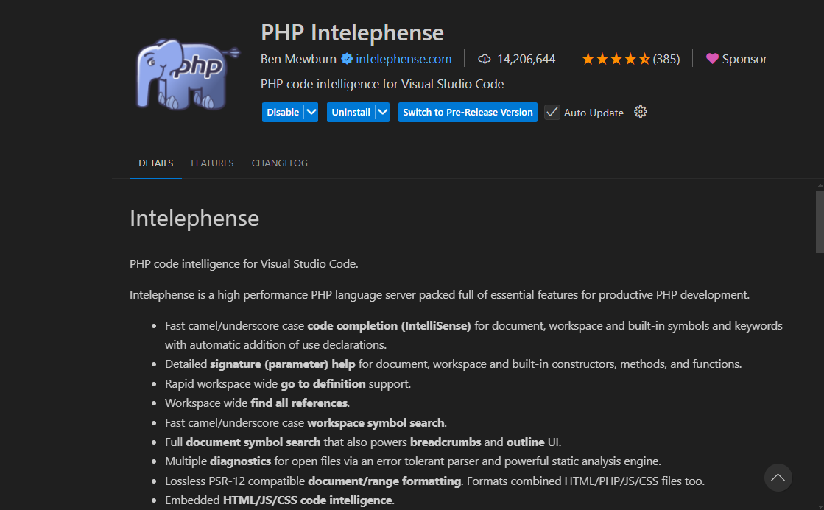
In vs code extensions search for

Slide 17
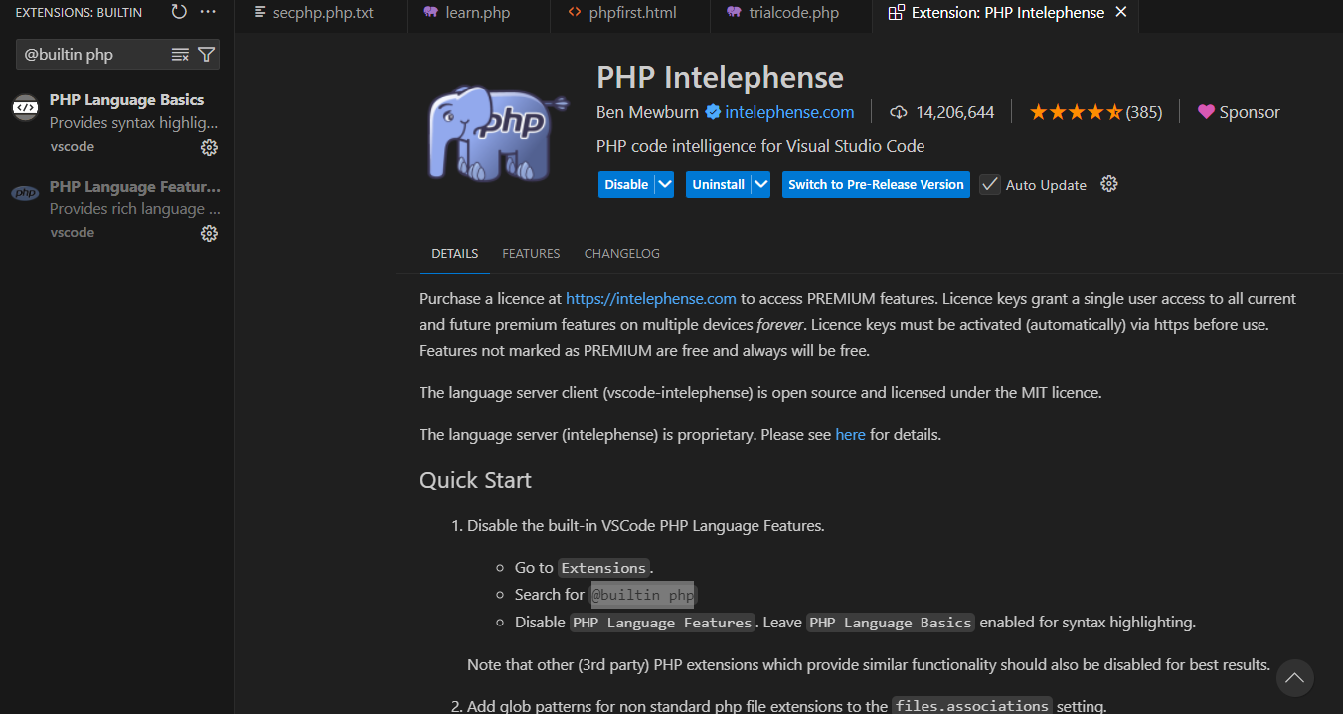

Slide 18
Select PhP language Feature from left hand side and disable it.
Again in extensions serach for PHP Intelephense and install it.
Install Code runner through extensions

Slide 19
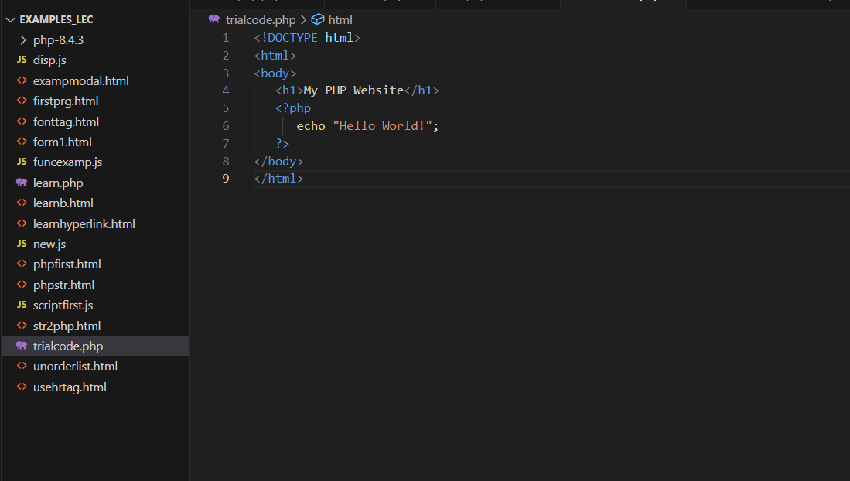
Write a program and save it as progname.php

Slide 20
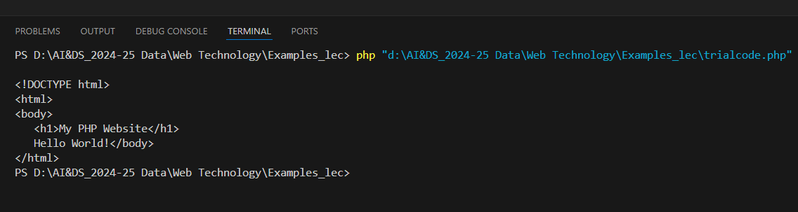
Press Run button and check the output in terminal.
Output of PHP code is seen.

Slide 21
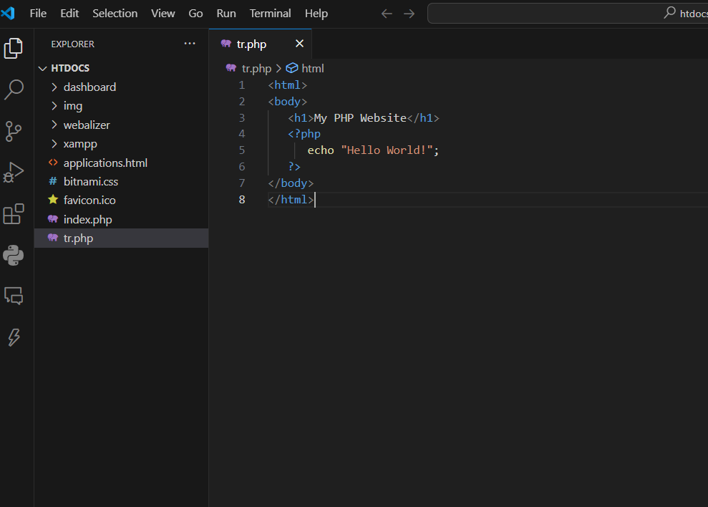
File select option open folder and browse for C:\xampp\htdocs

Slide 22
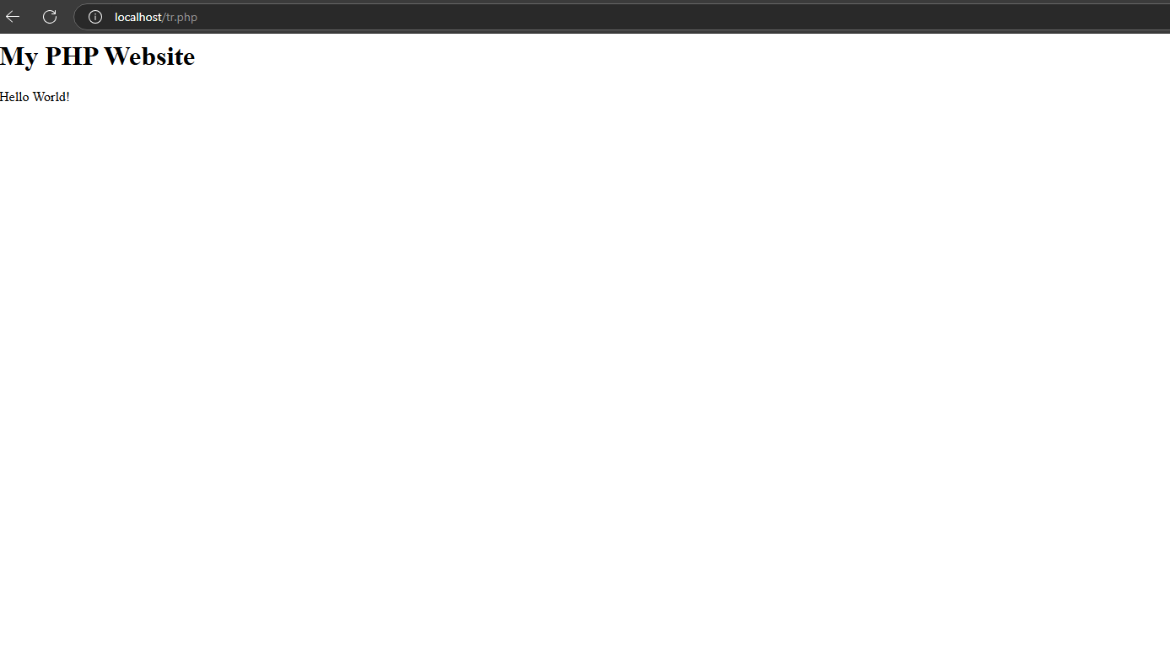
Open browser and in url section provide localhost/filename.php

Slide 23
Creating (Declaring) PHP Variables
In PHP, a variable starts with the $ sign, followed by the name of the variable.
Example
$x = 5;
$y = "John";

Slide 24
PHP Variables
Rules for PHP variables:
A variable starts with the $ sign, followed by the name of the variable
A variable name must start with a letter or the underscore character
A variable name cannot start with a number
A variable name can only contain alpha-numeric characters and underscores (A-z, 0-9, and _ )
Variable names are case-sensitive ($age and $AGE are two different variables)

Slide 25
Output Variables
The PHP echo statement is often used to output data to the screen.
Example
$x = 5;
$y = 4;
echo $x + $y;

Slide 26
PHP Data Types
PHP supports the following data types:
String
Integer
Float (floating point numbers - also called double)
Boolean
Array
Object
NULL
Resource

Slide 27
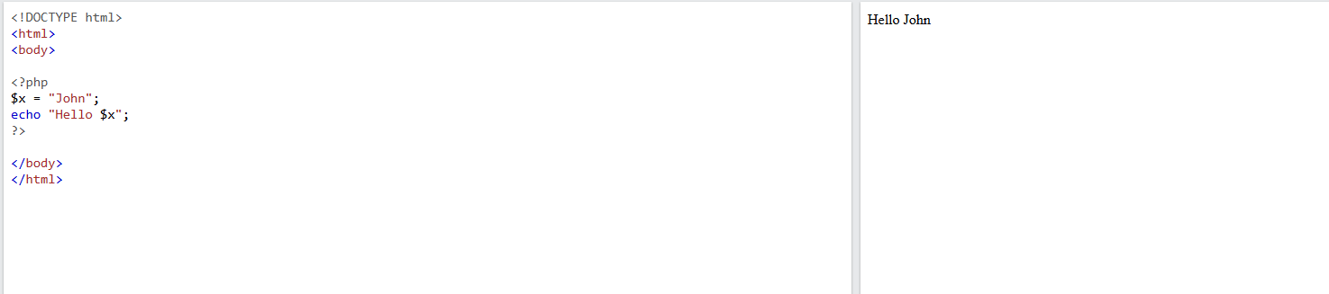
Double quoted Strings
Double quoted strings perform action on special characters.
E.g. when there is a variable in the string, it returns the value of the variable

Slide 28
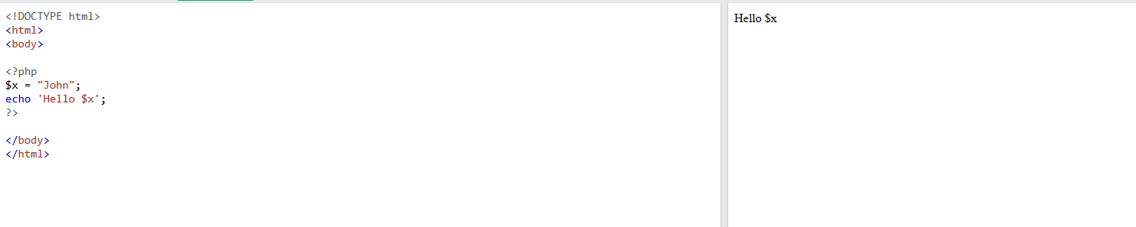
Single quoted Strings
Single quoted string literals returns the string as it is

Slide 29
String Length
The PHP strlen() function returns the length of a string.
Example: echo strlen("Hello world!");

Slide 30
Word Count
The PHP str_word_count() function counts the number of words in a string.
Example: echo str_word_count("Hello world!");

Slide 31
Search For Text Within a String
The PHP strpos() function searches for a specific text within a string.
If a match is found, the function returns the character position of the first match. If no match is found, it will return FALSE.
Example: echo strpos("Hello world!", "world");

Slide 32
How to read user or console input in PHP ?

Slide 33
Method 1: Using readline() function
It is a built-in function in PHP.
This function is used to read console input.
Accept a single input by prompting the user.
By default, the data type of the variable accepted through readline() function is string.
So for any other data type, we have to typecast it explicitly.

Slide 34
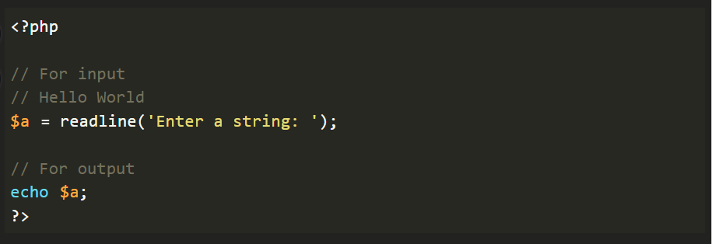
Using readline() function

Slide 35
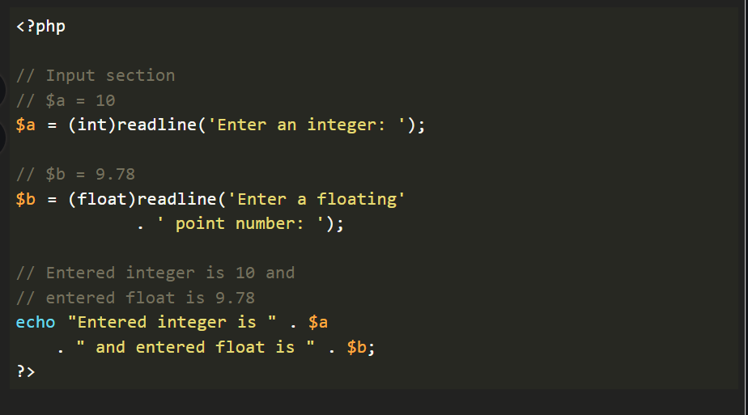
Using readline() function with typecasting

Slide 36
Accept multiple space separated inputs
Use another function explode() together with readline().
The first argument of explode() is the delimiter we want to use.
Syntax
explode(separator,string,limit)

Slide 37
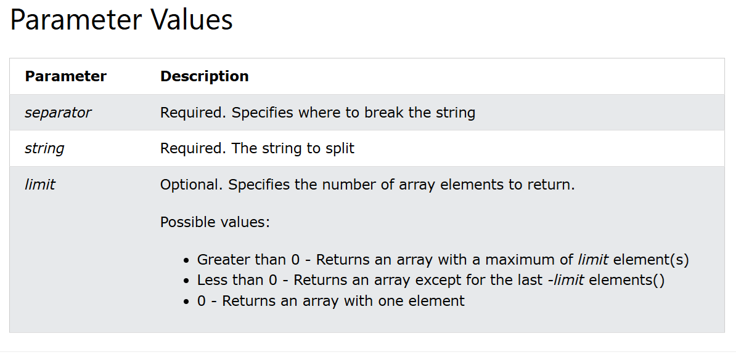
explode () parameter values

Slide 38
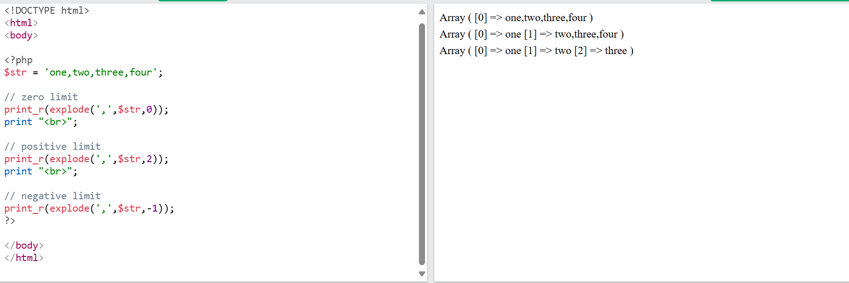
Example

Slide 39
Method 2: Using fscanf()
This function works same as the fscanf() function in C.
We can read 2 integers from Keyboard(STDIN).
No need to use explicit typecasting for fscanf() function, because it is done by the format specifiers , e.g. %d, %f, %c etc.
fscanf() function is much faster than the readline() function.

Slide 40
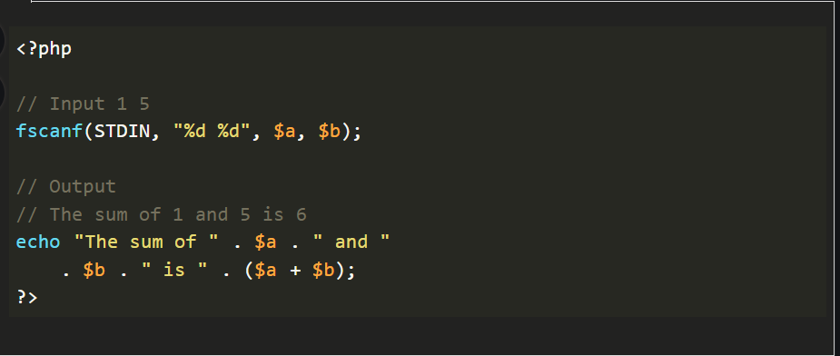
Example

Slide 41
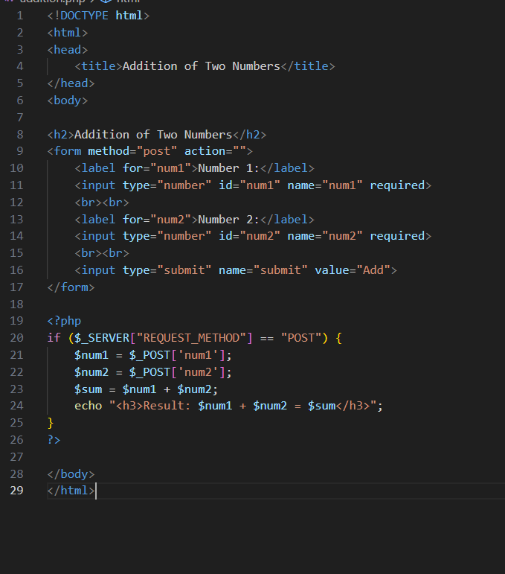
Addition of two numbers

Slide 42
PHP Conditional Statements
In PHP we have the following conditional statements:
if statement - executes some code if one condition is true
if...else statement - executes some code if a condition is true and another code if that condition is false
if...elseif...else statement - executes different codes for more than two conditions
switch statement - selects one of many blocks of code to be executed

Slide 43
Practice Programs
Write program to accept marks of 5 subjects, calculate its total and percentage. Check student percentage and display its division.
Write a PHP program to check whether a person is eligible to vote.

Slide 44
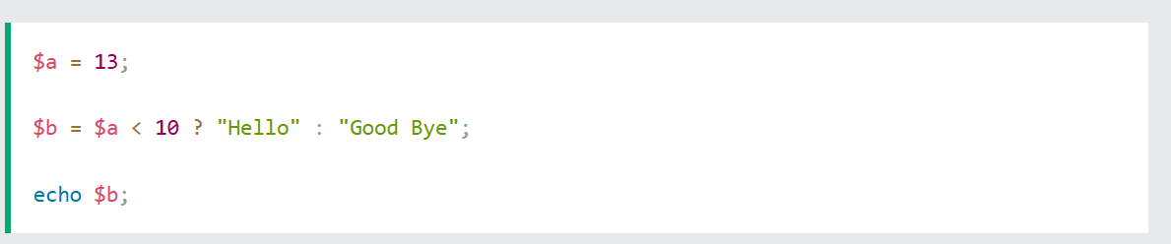
Short Hand If...Else

Slide 45
PHP Loops
In PHP, we have the following loop types:
while - loops through a block of code as long as the specified condition is true
do...while - loops through a block of code once, and then repeats the loop as long as the specified condition is true
for - loops through a block of code a specified number of times
foreach - loops through a block of code for each element in an array

Slide 46
Practice Programs
Write a program to display numbers from 5 to 15 using PHP loop.
Write a program to accept a number from user and calculate its factorial and display it.

Slide 47
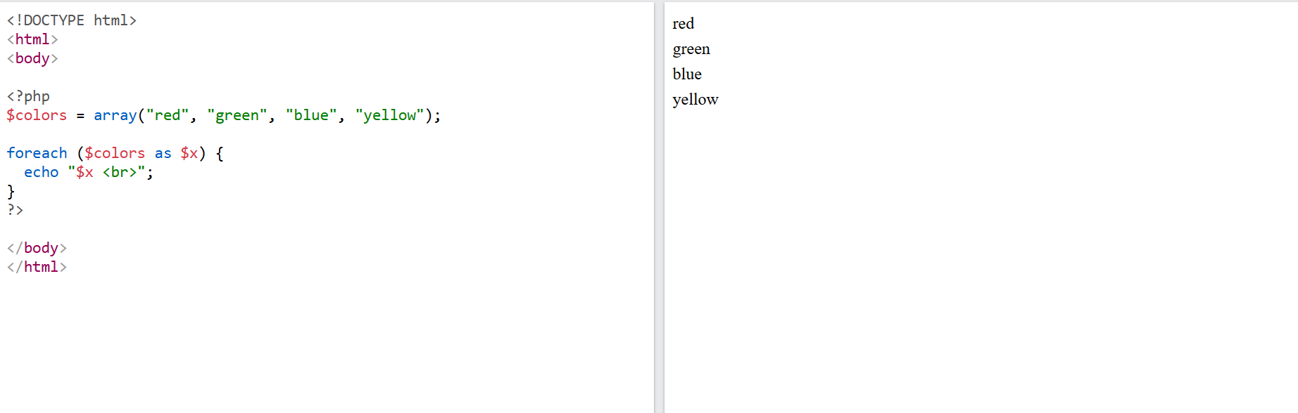
Example of foreach

Slide 48
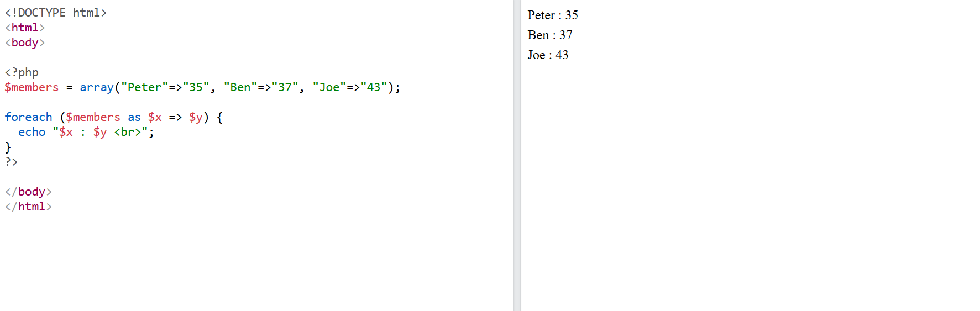
key and value in the foreach definition

Slide 49
Functions
PHP supports over 1000 built-in functions that can be directly from within a script, to perform a specific task.
It is also possible to create your own functions. (User defined functions)

Slide 50
Create a function
A user-defined function declaration starts with keyword function, followed by the name of the function.
Example: function mymsg()
{
echo “Hello World”;
}

Slide 51
Call a function
To call a function, write its name followed by parentheses().
Example: function mymsg()
{
echo “Hello World”;
}
mymsg();

Slide 52
PHP Function Arguments
Arguments are specified after the function name, inside the parentheses.
One can add many arguments as you want, just separate them with a comma.

Slide 53
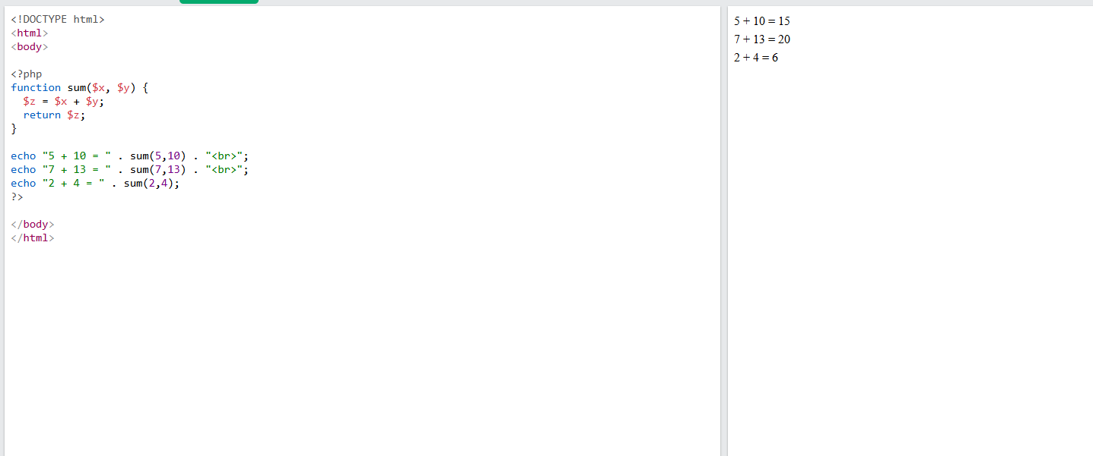

Slide 54
Passing Arguments by Reference
In PHP, arguments are usually passed by value, which means that a copy of the value is used in the function and the variable that was passed into the function cannot be changed.
When a function argument is passed by reference, changes to the argument also change the variable that was passed in. To turn a function argument into a reference, the & operator is used.

Slide 55
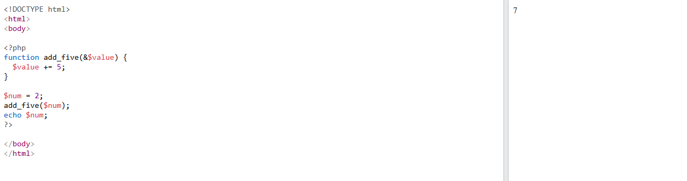
Example of Passing Arguments by Reference

Slide 56
Variable Number of Arguments
By using the ... operator in front of the function parameter, the function accepts an unknown number of arguments.
This is also called a variadic function.
The variadic function argument becomes an array.

Slide 57
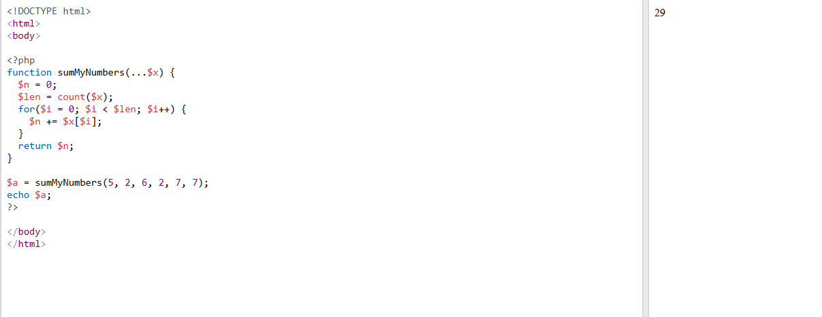
Example of variadic function.

Slide 58
Arrays in PHP

Slide 59
Introduction
An array in PHP is an ordered map that associates values to keys.
A PHP array can be used to implement different data structures such as a stack, queue, list (vector), hash table, dictionary, etc.
The value part of an array element can be other arrays. This fact can be used to implement tree data structure and multidimensional arrays.

Slide 60
Built-in Array
The built-in array() function uses the parameters given to it and returns an object of array type.
One or more comma-separated parameters are the elements in the array.
Syntax: array(mixed ...$values): array
Each value in the parenthesis may be either a singular value (it may be a number, string, any object or even another array), or a key-value pair.
The association between the key and its value is denoted by the "=>" symbol.

Slide 61
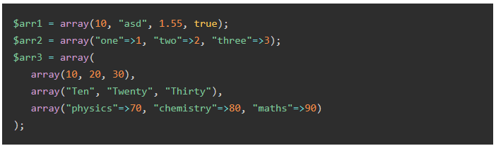
Example

Slide 62
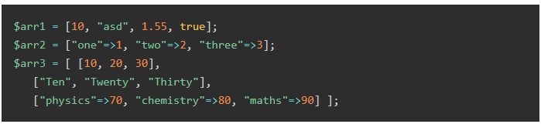
Using Square Brackets [ ]
Instead of the array() function, the comma-separated array elements may also be put inside the square brackets to declare an array object.

Slide 63
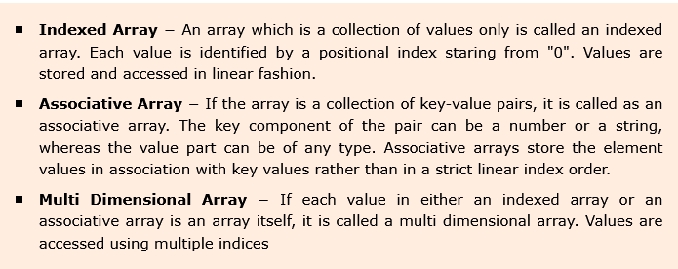
Types of Arrays in PHP

Slide 64
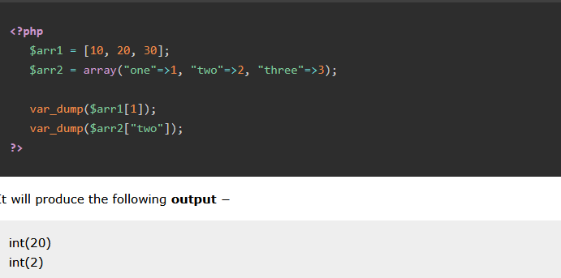
Accessing the Array Elements
To access any element from a given array, you can use the array[key] syntax.

Slide 65
Traversing an Indexed Array in PHP
Any type of PHP loop can be employed to traverse an array.
If we want to use a for or while loop, we have to find the number of elements in the array with count() function and use its value as the test condition for the counted for or while loop.

Slide 66
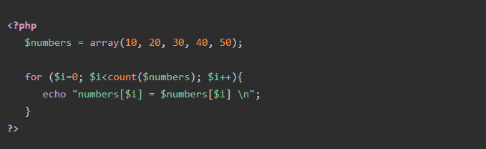
The following code uses a for loop to list all the elements in an indexed array.

Slide 67
PHP Files and I/O

Slide 68
PHP - Files & I/O
Functions related to files are:
Opening a File
Reading a File
Writing a File
Closing a File

Slide 69
Opening a File
The PHP fopen() function is used to open a file.
It requires two arguments stating first the file name and then mode in which to operate.

Slide 70
Read File - fread()
The fread() function reads from an open file.
The first parameter of fread() contains the name of the file to read from and the second parameter specifies the maximum number of bytes to read.

Slide 71
Close File - fclose()
The fclose() function is used to close an open file.
The fclose() requires the name of the file (or a variable that holds the filename) we want to close.

Slide 72
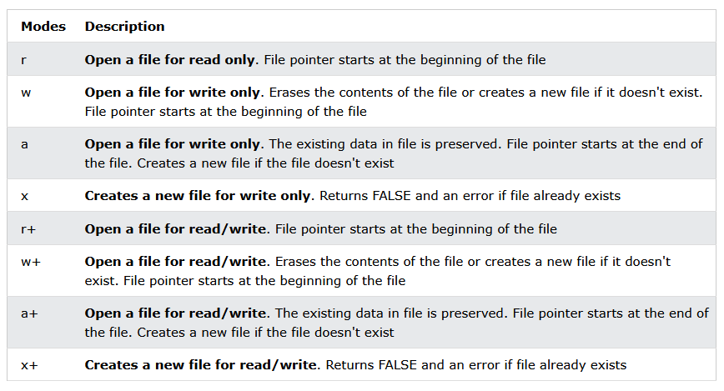
Files modes can be specified as one of the six options

Slide 73
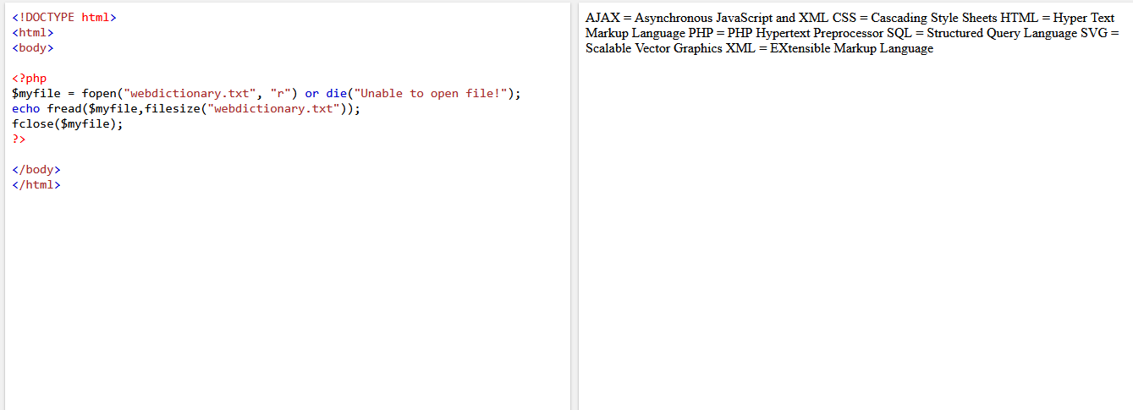
Example to read a file

Slide 74
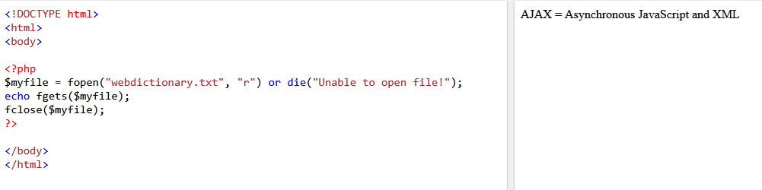
Read Single Line - fgets()
The fgets() function is used to read a single line from a file.

Slide 75
Check End-Of-File - feof()
The feof() function checks if the "end-of-file" (EOF) has been reached.
The feof() function is useful for looping through data of unknown length.

Slide 76
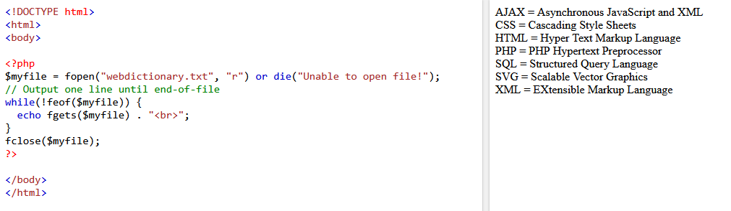
Example of feof()

Slide 77
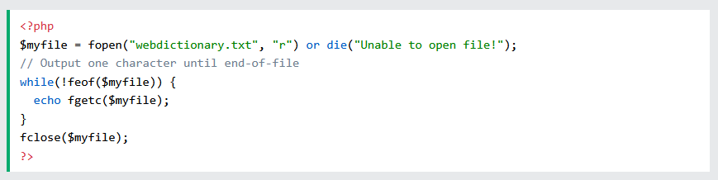
Read Single Character - fgetc()
The fgetc() function is used to read a single character from a file.

Slide 78
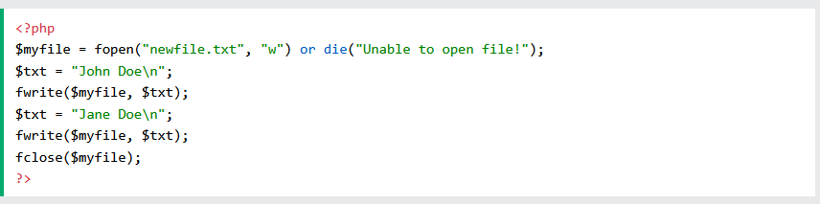
Write to File - fwrite()
The fwrite() function is used to write to a file.
The first parameter of fwrite() contains the name of the file to write to and the second parameter is the string to be written.

Slide 79
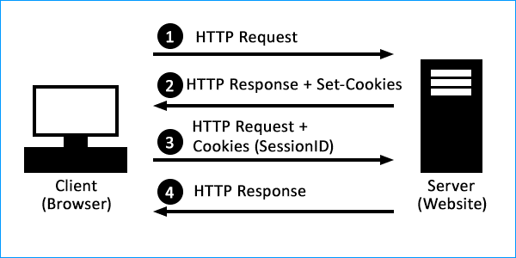
Understanding Cookies

Slide 80
Cookies
A cookie is often used to identify a user.
A cookie is a small file that the server embeds on the user's computer.
Each time the same computer requests a page with a browser, it will send the cookie too.
With PHP, you can both create and retrieve cookie values.

Slide 81
Create Cookies
A cookie is created with the setcookie() function.
Syntax
Only the name parameter is required. All other parameters are optional.

Slide 82
Create/Retrieve a Cookie
The following example creates a cookie named "user" with the value "John Doe".
The cookie will expire after 30 days (86400 * 30). The "/" means that the cookie is available in entire website (otherwise, select the directory you prefer).
We then retrieve the value of the cookie "user" (using the global variable $_COOKIE). We also use the isset() function to find out if the cookie is set

Slide 83
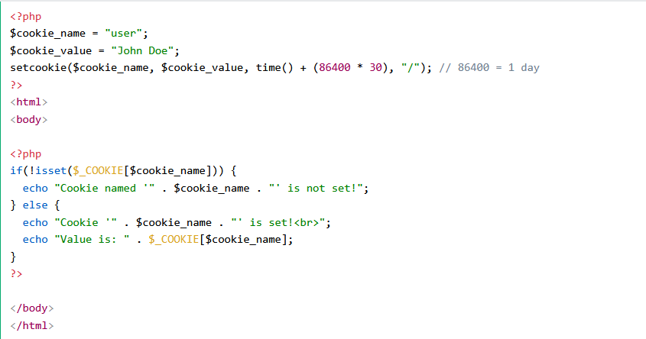
Example

Slide 84
What are cookies used for?
User sessions: Cookies help associate website activity with a specific user. A session cookie contains a unique string (a combination of letters and numbers) that matches a user session with relevant data and content for that user.
Personalization: Cookies help a website "remember" user actions or user preferences, enabling the website to customize the user's experience.

Slide 85
What are cookies used for?
Tracking: Some cookies record what websites users visit. This information is sent to the server that originated the cookie the next time the browser has to load content from that server. With third-party tracking cookies, this process takes place anytime the browser loads a website that uses that tracking service.

Slide 86
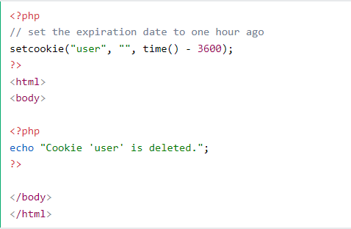
Delete a Cookie
To delete a cookie, use the setcookie() function with an expiration date in the past

Slide 87
Session
“Session” is the term used to refer to a visitor’s time browsing a web site. It’s meant to represent the time between a visitor’s first arrival at a page on the site and the time they stop using the site.

Slide 88
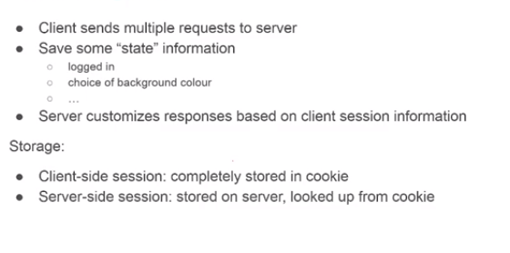
Session Management

Slide 89
Sessions
A session is a way to store information (in variables) to be used across multiple pages.
Unlike a cookie, the information is not stored on the users computer.
Session variables store user information to be used across multiple pages (e.g. username, favorite color, etc).
By default, session variables last until the user closes the browser.
So; Session variables hold information about one single user, and are available to all pages in one application.

Slide 90
PHP Session
A session is started with the session_start() function.
Session variables are set with the PHP global variable: $_SESSION.
The session_start() function must be the very first thing in your document. Before any HTML tags.

Slide 91
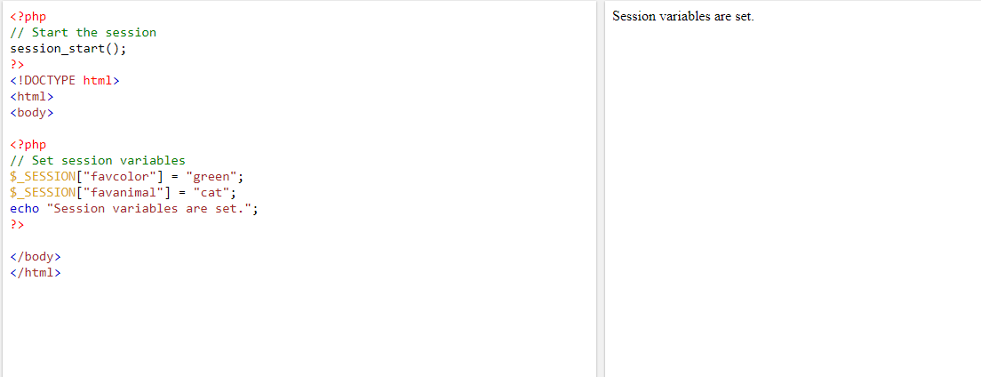
Example to start a Session

Slide 92
Get PHP Session Variable Values
session variables are not passed individually to each new page, instead they are retrieved from the session we open at the beginning of each page (session_start()).
All session variable values are stored in the global $_SESSION variable

Slide 93
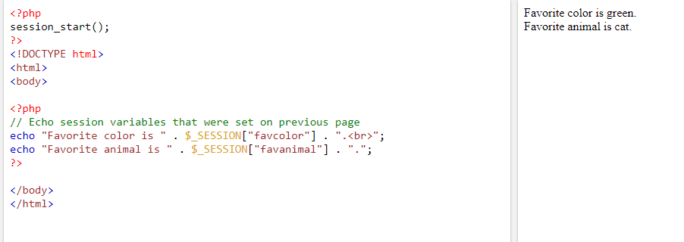
Example

Slide 94
Destroy a PHP Session
To remove all global session variables and destroy the session, use session_unset() and session_destroy()

Slide 95
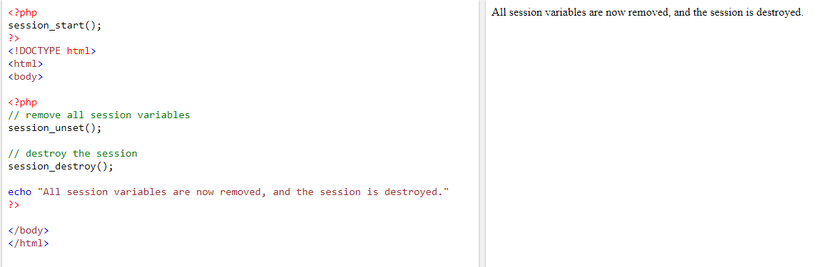
Example

